Slide 1
Predictors for Parkinson’s Disease
A Study of Voice Recordings for Predictive Markers
Christine Hathaway
Bellevue University

Slide 2
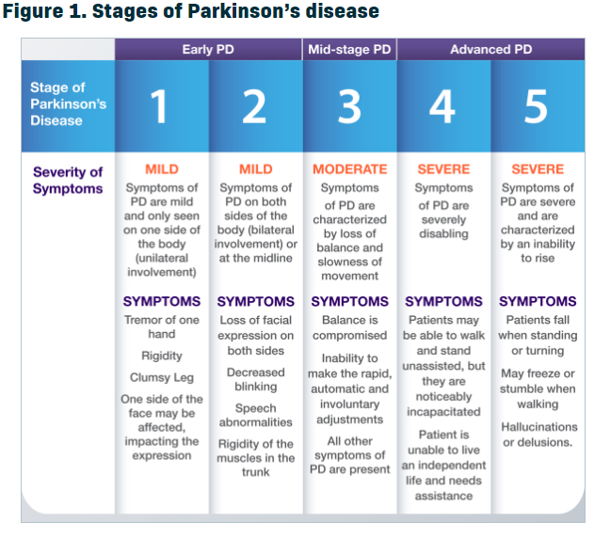

Intro/Background of the Problem
Source: ParkinsonsDisease.net https://parkinsonsdisease.net/basics/stages/

Slide 3
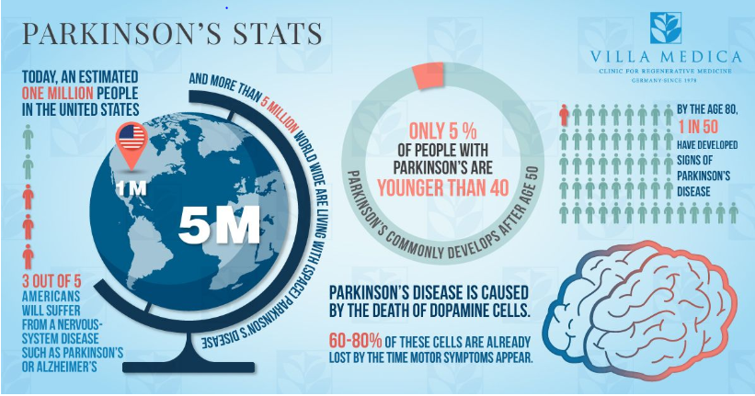
Parkinson’s Statistics
Figure 2
Source: Villa Medica https://villa-medica.com/cell-therapy-for-parkinsons/

Slide 4
Business Question
No test for Parkinson’s disease
Clinical diagnosis
Speech patterns
Early detection
Business Question:
Are some speech indicators better than others at predicting PD?

Slide 5
Understanding the Data
31 participants
23 diagnosed with Parkinson’s disease
Variables represent various measures of speech
Dataset created by Max Little at University of Oxford
Speech signals recorded at National Centre for Voice and Speech in Denver, Colorado

Slide 6
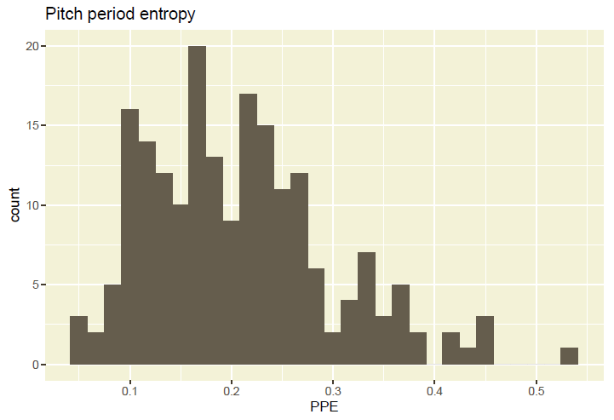
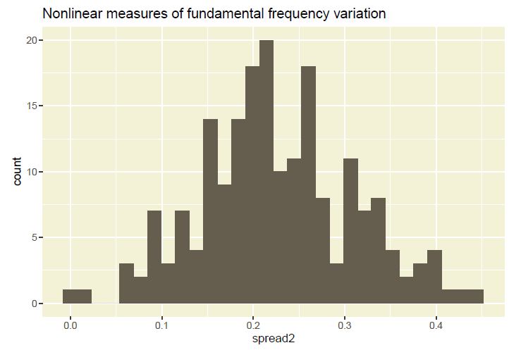
Exploratory Data Analysis (EDA)

Slide 7
Modeling
Regression modeling in R did not produce significant results
Small data set responds better to gradient boosting
Xgboost in Python produced results with significant findings

Slide 8
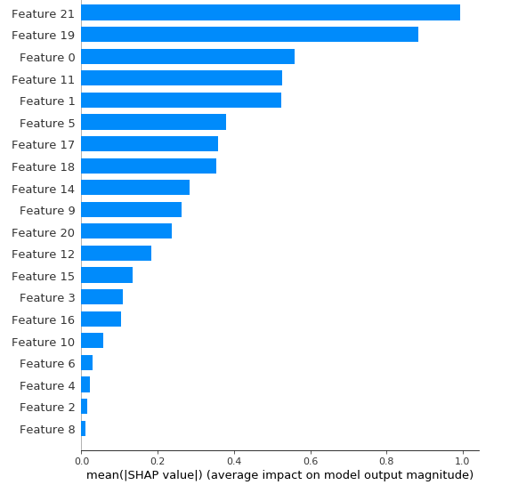
Results

Slide 9
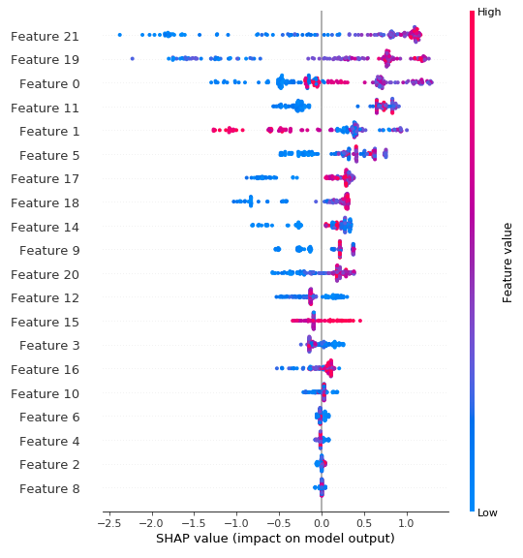
Results

Slide 10
Conclusion
PPE measurement strongly correlated to Parkinson’s disease
Could lead to new test for Parkinson’s disease
Crucial discovery in early detection

Slide 11
References
Figure 1: Joeken, H. (November, 17 2017). Parkinson’s Disease: The Golden Age Challenge. Retrieved from Villa Medica: https://villa-medica.com/cell-therapy-for-parkinsons/
Figure 2: Health Union. (February, 23 2017). What Are the Stages of Parkinson’s Disease? Retrieved from ParkinsonsDisease.net: https://parkinsonsdisease.net/basics/stages/

